Slide 1
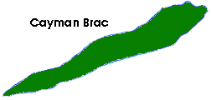
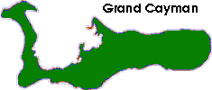
Transporation in The Cayman Islands

Slide 2
Transporation in The Cayman Islands Lesson 1.

Slide 3
Transportation
When humans, animals and goods move from one place to another we call this transport or transportation.
How we move ourselves, animals or goods from one place or another is called mode. There are three main modes of transportation. These are land, water or air.
Can you think of any other modes of transportation?

Slide 4
Land Transportation
We move from place to place in our houses, at our jobs and from country to country.
In the early 1900s, all through our three islands, Caymanians walked miles upon miles on foot just to see family or friends or to trade goods. In Grand Cayman, they walked from East End or Bodden Town, West Bay and North Side to the capital, George Town.
Some people used animals to help them quickly move from place to place. But, the Mail Lady carried a thatch basket containing mail for the Eastern Districts. Who was she?
Questions. List all the ways you move around in your home?
Now, consider people who cannot walk. How do people who cannot walk move about on their own?
Ask a parent or relative how humans used animals for transportation.

Slide 5
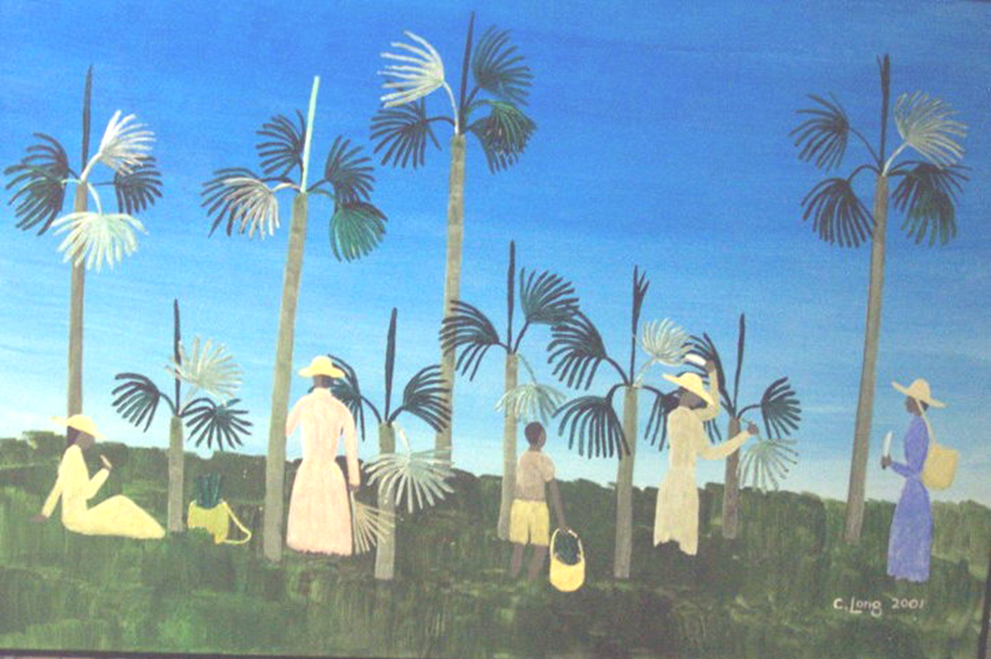
Study this painting called ‘Thatch Gathering’ by Charles Long.
What are the people doing?
What mode of transportation did they use to get there?
What will the women use to carry their goods?

