Slide 1
Transporation in The Cayman Islands

Slide 2
Transporation in The Cayman Islands Lesson 2.

Slide 3
Sea Transportation
In the early 1900s, all through our three islands, Caymanians built boats. They built big boats like schooners, yawls and sloops. And, they built small boats, like dinghys and catboats.
The most popular boat model built here was the two-masted schooner. Some famous schooner names are Wilson, Adams, and Goldfield.
Schooners were used in the turtling industry. They transported men and equipment to and from the Mosquito Coast of Nicaragua.
Schooners were also used to transport people from country to country. People travelled to Jamaica, Cuba and the United States for goods and for medical attention.
The Arch’s built a large passenger vessel in 1928. The Nunoca did not rely on wind power. It speedily carried relief supplies to Cayman Brac after the 1932 storm.

Slide 4
Sea Transportation
The most popular small boat was the Cayman Catboat.
Square stern dinghys were commonly built here. But this was after a man from Cayman Brac, invented the Cayman Catboat in the 1920s.
Catboats were double-ended vessels. This allowed the boats to quickly change directions. They could move either backwards or forwards. The invention of the Catboat was of tremendous benefit to Turtle Rangers. Because catboats were stored when not in use, in time the wood vessels dried out and became lighter.
Who built the first Cayman Catboat?
Questions. List any other Caymanian made boats?
Now, consider other types of boats used in other countries. What is the name of the vessel used by Caribbean Indians? How were these vessels made?
Ask a parent or relative what is the first vessel to travel to Cayman? Now answer. Who travelled on this vessel?. What was the year this vessel arrive?

Slide 5
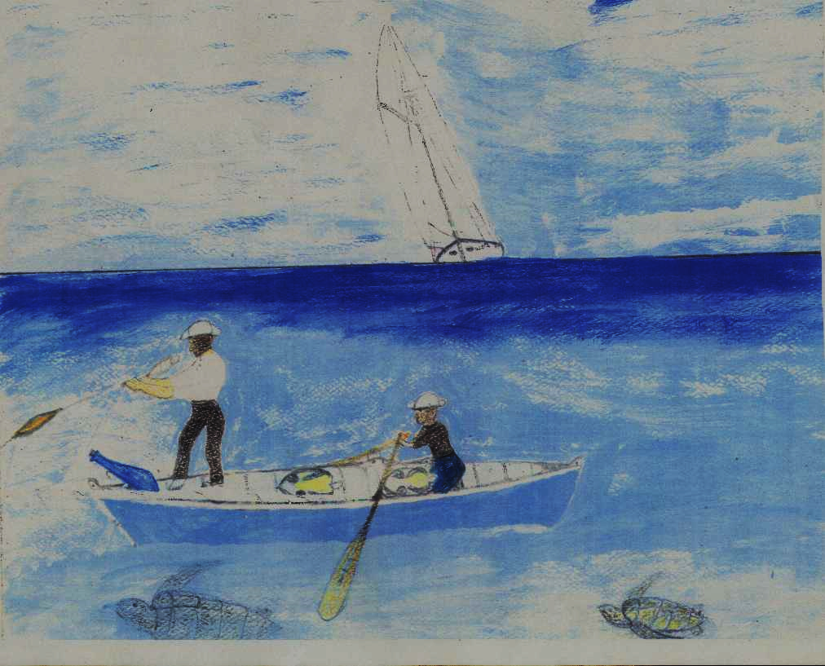
Study this painting called ‘Catboat and Schooner’ by Harvey Ebanks.
Consider that the men are in Nicaragua.
Name the two types of vessels you see.
What are the men doing?
What mode of transportation are they using?
How will the men transport their catch and the catboat back home?

