Slide 2
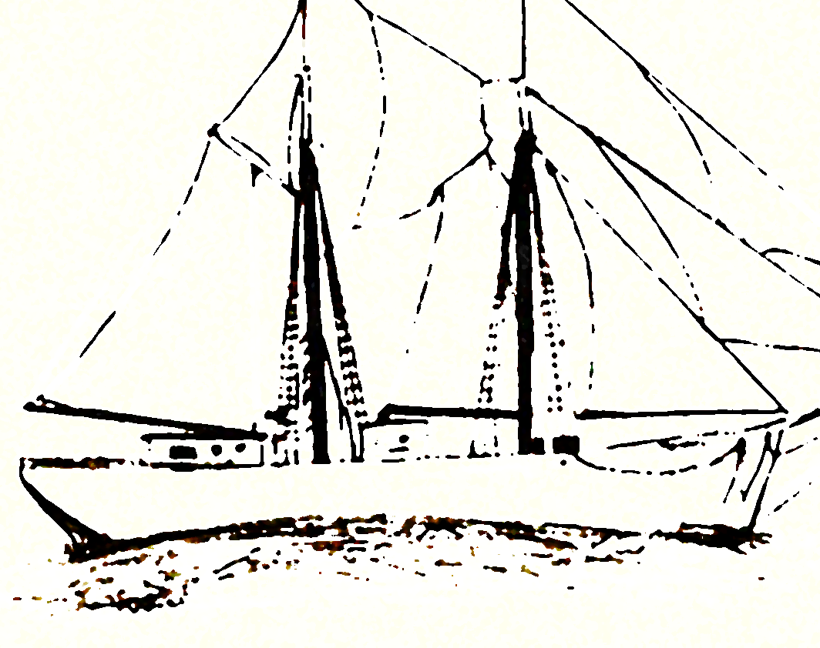
SHIPS
AND SHIPBUILDING

Slide 3
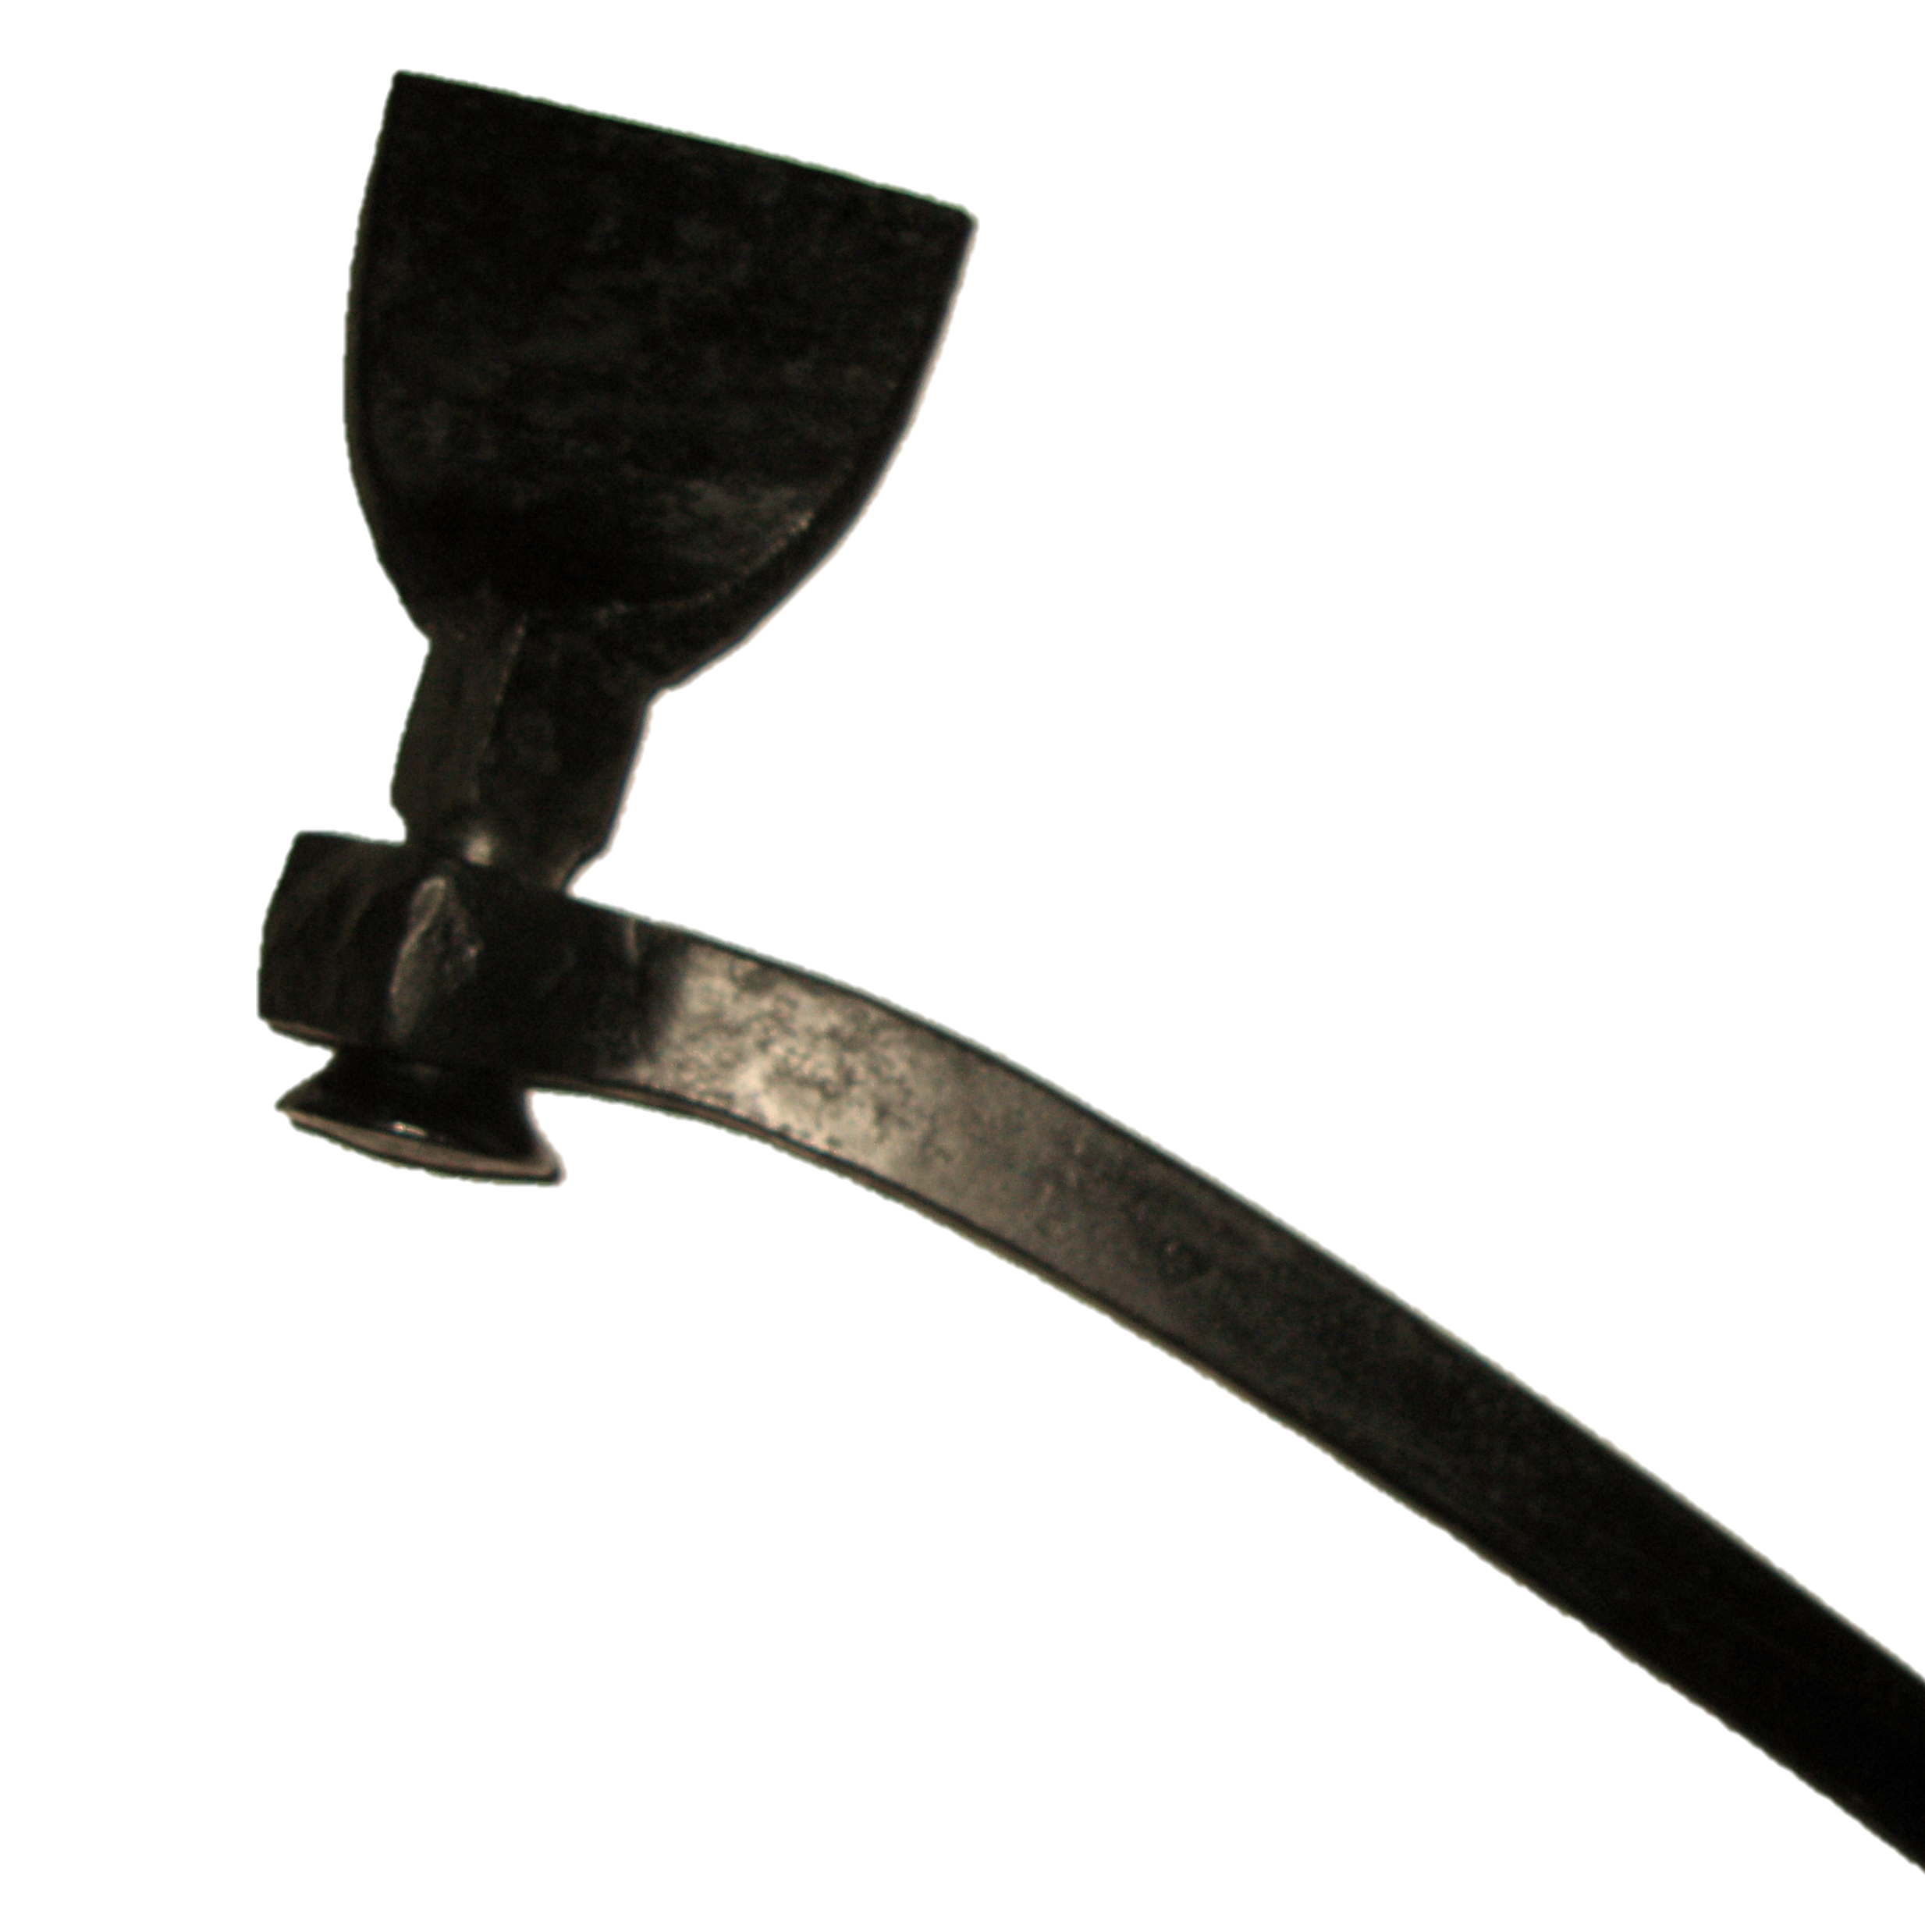
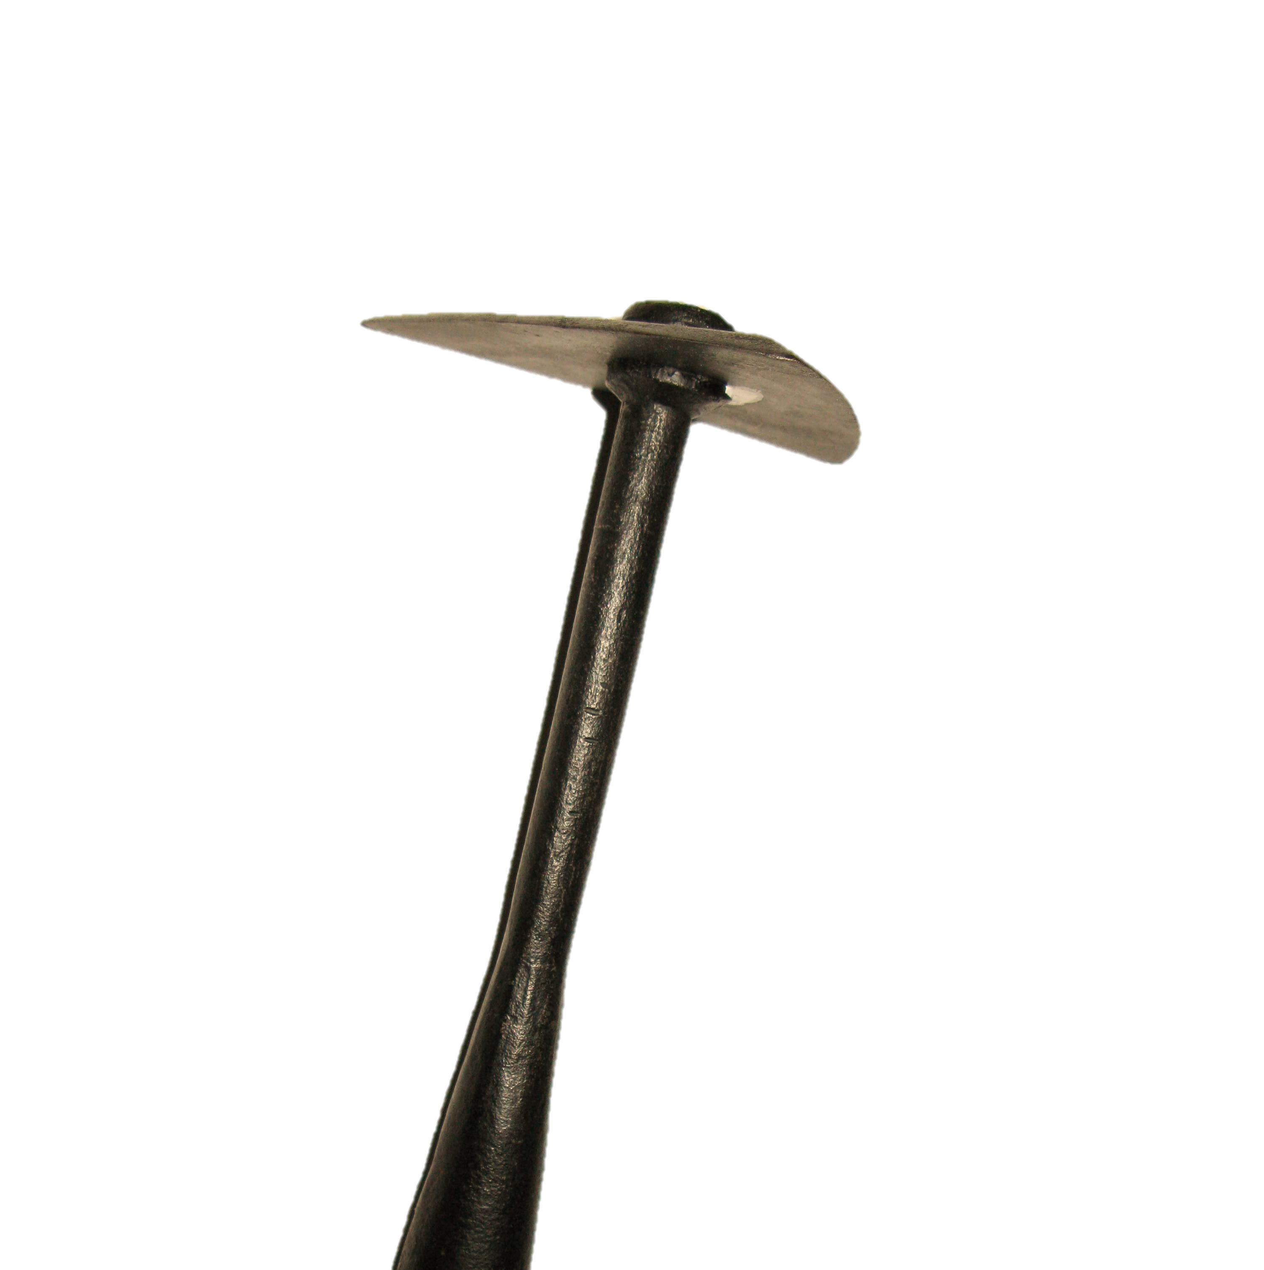
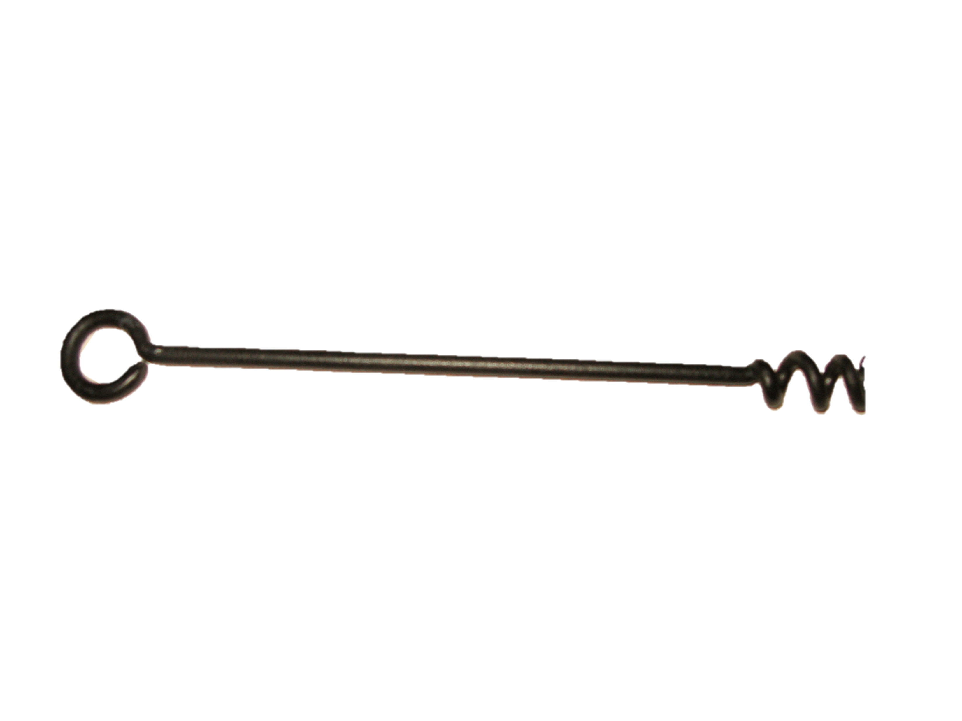
Down to the Sea
For centuries, Caymanians have "gone down to the sea" in ships made only with the basic tools of the shipwright's trade. With little capital or sophisticated equipment, they found ways to design and build seagoing vessels with tools such as the adze, saw, chisel, plane, and brace.
Caulking Iron
Pitch Scraper
Auger
Pitch Scrapper
Caulking Iron

Slide 4
Ships Templates / Half Models
Using local hardwoods, imported softwoods and fittings, and even materials salvaged from shipwrecks. It could take seven men four months, working from sunrise to sunset, to build a 60-ton schooner.

Slide 5
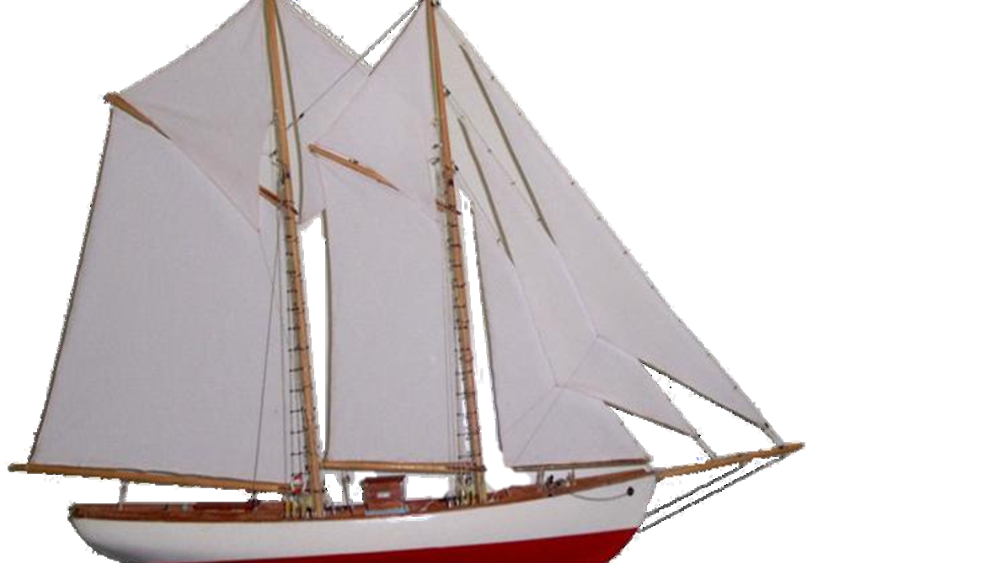
The last traditional launching of a Caymanian ship, the Trial, occurred on January 3, 1967 in Cayman Brac.
Today, names such as the Goldfield, the Cimboco, and the Caymania still evoke memories of a proud tradition.

Slide 6
Consider:
What key factors contributed to the demise of the shipbuilding industry.

